Slide 1
TRUSS_02
Final project presentation

Slide 2

Index
Project description
Initial model
Exploration
Exploitation
$$\text{P}\left(\text{B} | \text{A}\right)\text{=}\frac{\text{P}\left(\text{A} | \text{B}\right)\text{P}\text{(}\text{B}\text{)}}{\text{P}\text{(}\text{A}\text{)}}$$

Slide 3
Project description

Slide 4
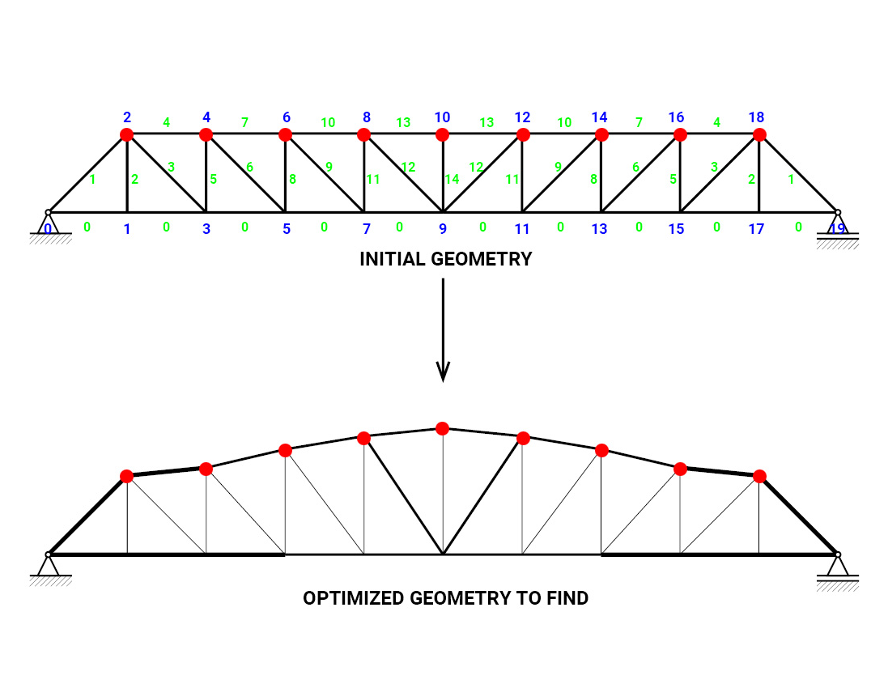
Project description
Geometry
Nodal coordinates and cross-section
Symmetry condition
Movement permitted in y-axis for nodes at top chord
Fixed cross-section for bottom chord
Optimize for
Frequency / weight

Slide 5
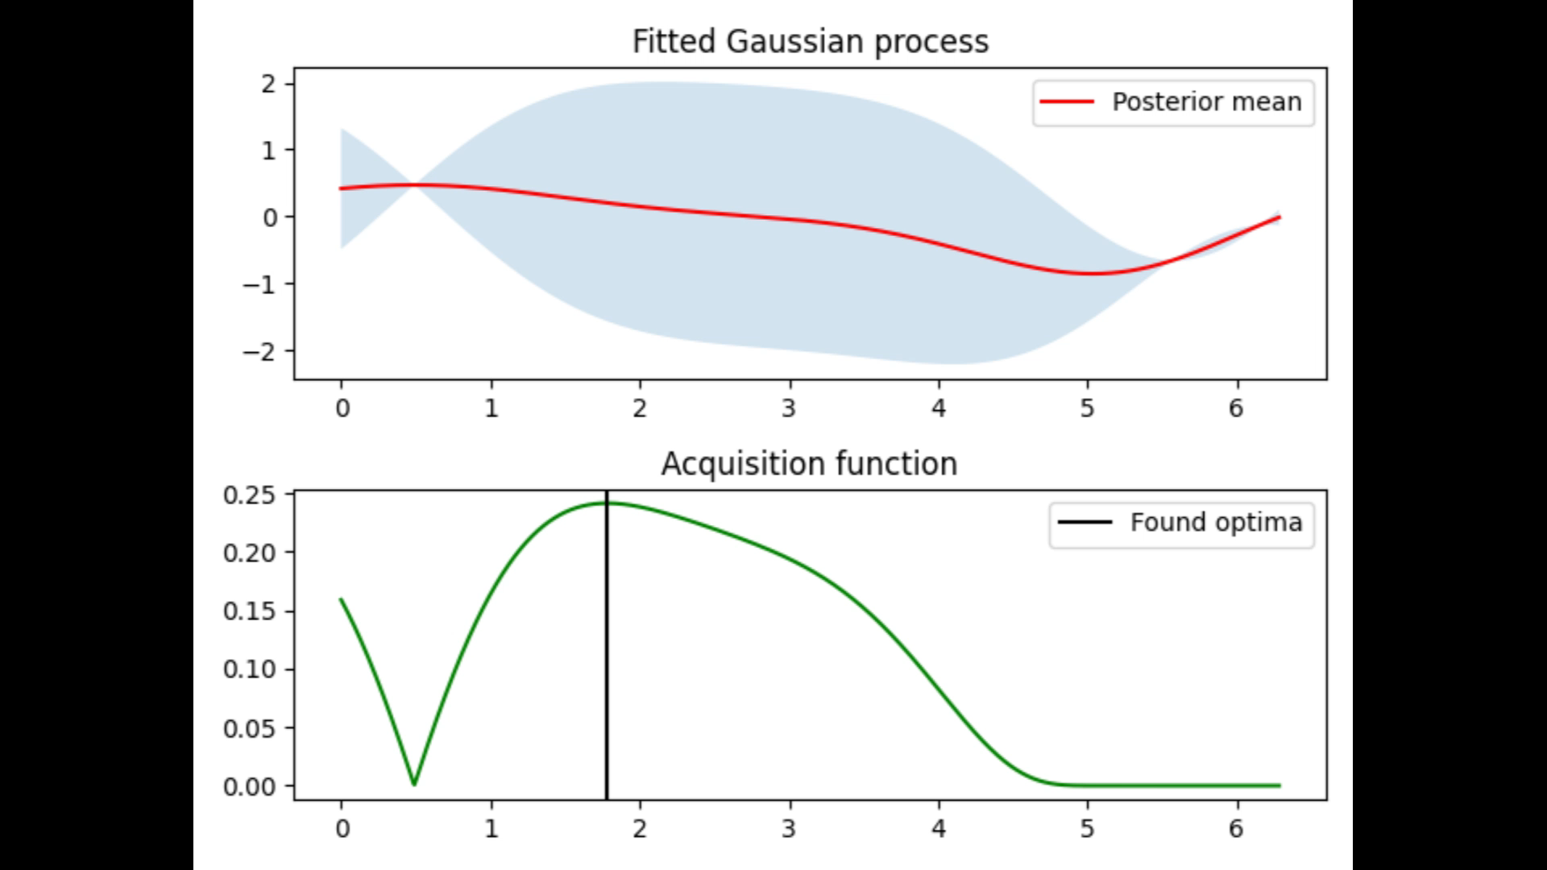
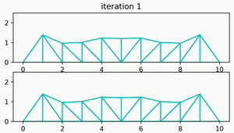
Project description - Bayesian optimization ^{[1]}
“Black box” function
FEA package
Acquisition function
Find next point of interest
Surrogate model
Collection of all analyses
Loss function
Scoring the model, guiding towards optimal

Slide 6
Initial model

Slide 7
Initial model – FEA computation implementation
Python file created for all handling with FEA package
On initialisation – resets all previous modifications
Updating areas and node-location
Updating the .geom file
Instructing FEA package for running
Post processing FEA
Plotting structure for ease of understanding

Slide 8
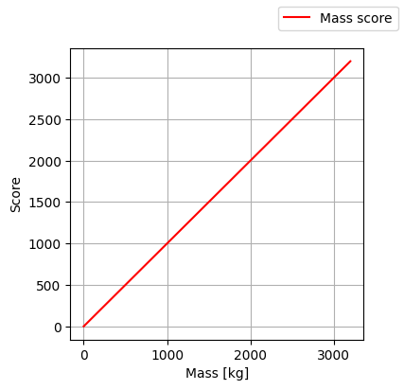
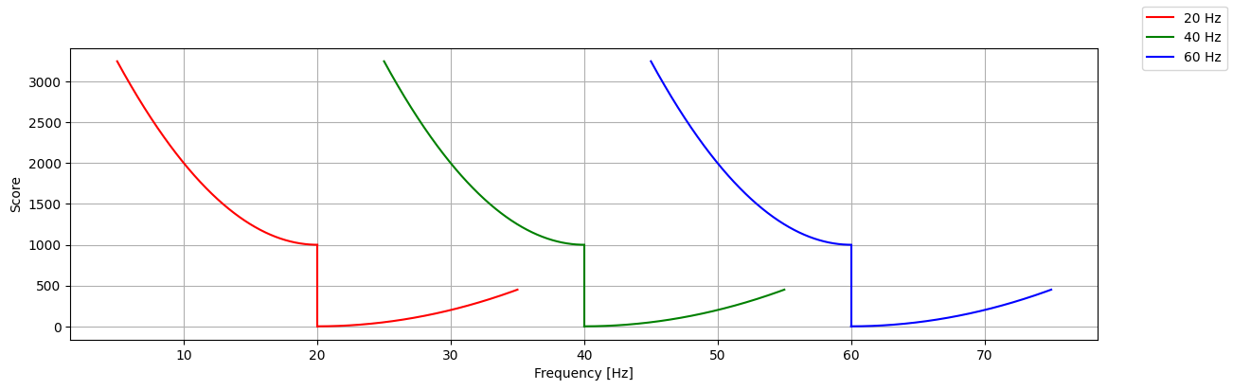
Initial model
Bayesian package: pyGPGO
Loss function:
Acquisition function: Expected improvement
Covariance matrix: Squared exponential

Slide 9
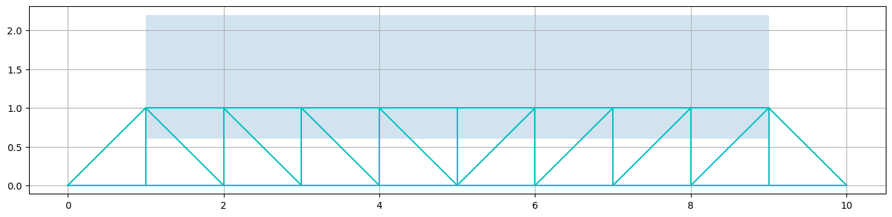
Initial model
Node location boundaries:
Area boundaries:
0.1 cm²
10 cm²

Slide 10
Exploration
of model parameters

Slide 11
Verifications – path to generalization
Loss function
Constrained areas
Constrained displacements
Kernel
Initial evaluations
Acquisition function

Slide 12
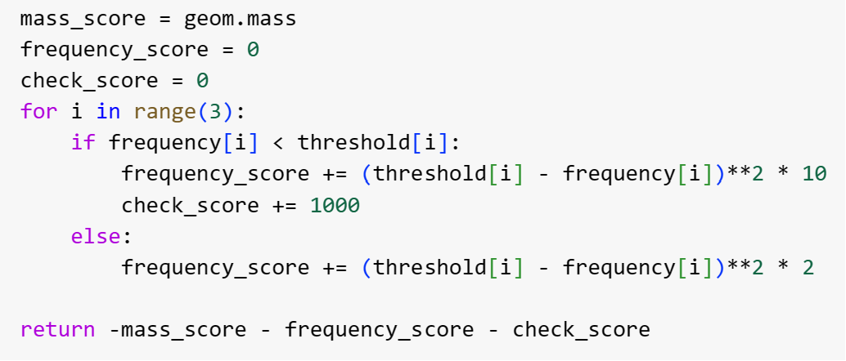
Loss function
Based on the sum of following scores:
Mass
Natural frequency (20 Hz, 40 Hz, 60 Hz)
Check (penalty)
Compare performance for limitations on frequency (4 scenarios)
All frequency bands guided towards known threshold (1)
Remove upper bound in searching optimal solution for:
60 Hz (2)
40 & 60 Hz (3)
All three bands (4)
Notes:
Want to talk about:
Loss function was created with regards to the score for the mass and the first three modes for the natural frequency of the structure, in addition to a penalty if the minimum threshold was breached.
We considered four initial scenarios in which: (1) all frequency bands were guided towards the known threshold of 20, 40, 60 Hz, and subsequent cases where the upper bound of the least squares function was eliminated for the listed bands on the slides

Slide 13
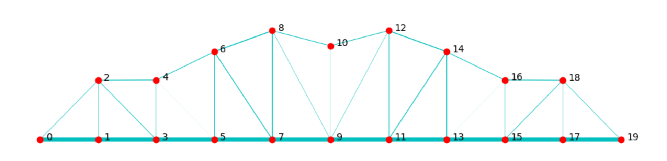
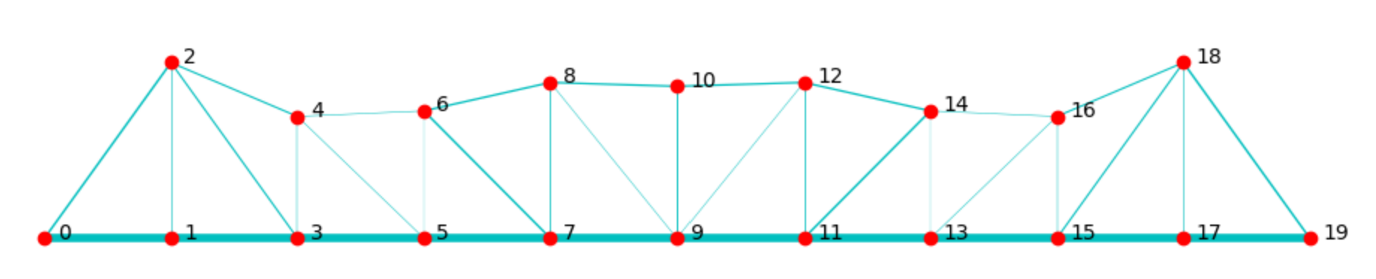
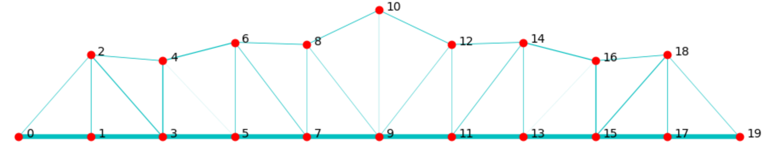
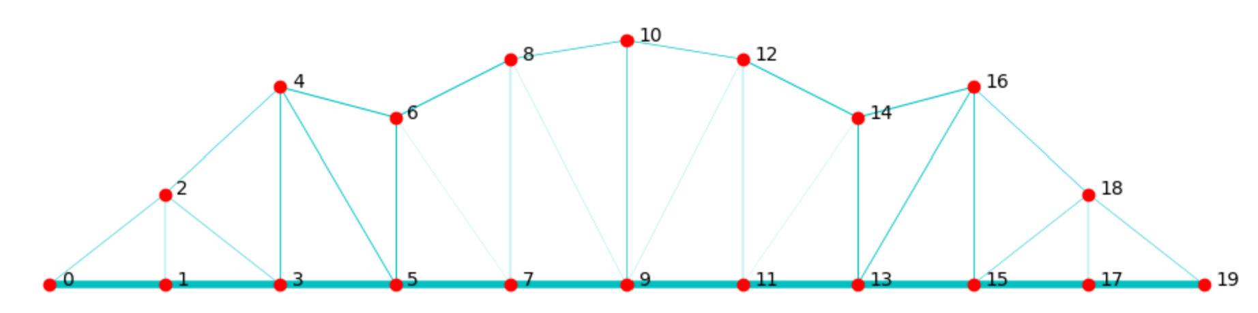
Loss function – Comparison 1
 | Natural frequencies [Hz] | Best score | Total mass [kg] | Computation time [Hr] | Structure visualization for best iteration
Case 1 | 22.13, 46.83, 61.97 | 591.09 | 480.860 | 1.62
Case 2 | 18.14, 50.93, 93.04 | 1511.33 | 476.760 | 3.39
Case 3 | 19.40, 52.24, 66.39 | 1453.65 | 449.990 | 3.25
Case 4 | 21.37, 34.19, 72.62 | 1443.04 | 443.04 | 2.55
Notes:
The green values represent values that achieved minimum requirements for the frequencies, while the red indicates violations.
In case (1) where all frequency bands were guided, we saw a moderate result with the most efficient computation time.
In the subsequent cases, at least one of three modal frequencies would not be met, and this is reflected in the best score with the additional penalty of 1000 points.
While the total mass was able to improve, we brainstorm additional considerations in exploring the loss function to balance, the score for the mass and natural frequency, especially with regards to the computation time since the generalization with be associated with half the level of efficiency with the same number of 500 iterations.

Slide 14
Loss function – Additional considerations
Change the coefficient for mass score
Optimization for all frequency bands (Case 1) with lowest C.T.
x10 (5)
x100 (6)
Investigate further generalization by optimizing for 20 Hz (Case 3)
Apply combinations weights to lower bound of frequency score and the mass
x100 frequency (7)
x5 mass; x100 frequency (8)
x10 mass; x100 frequency (9)
x10 mass; x10 frequency (10)
Notes:
Here are the considerations which I will delve further in the next slide with the results.

Slide 15
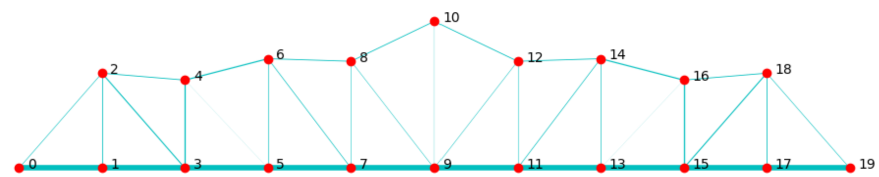
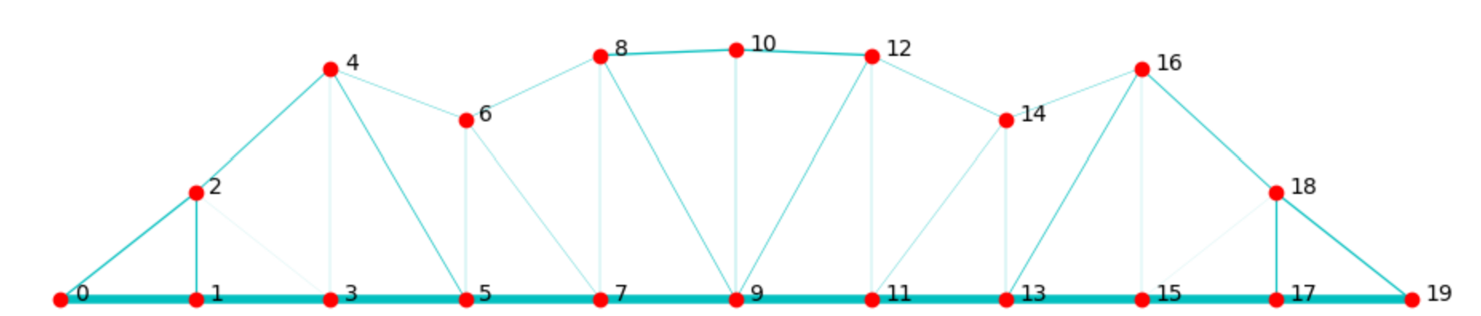
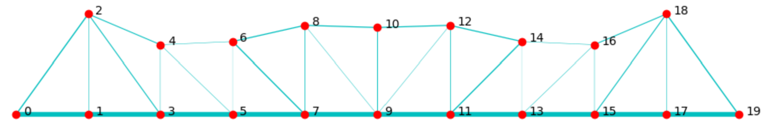
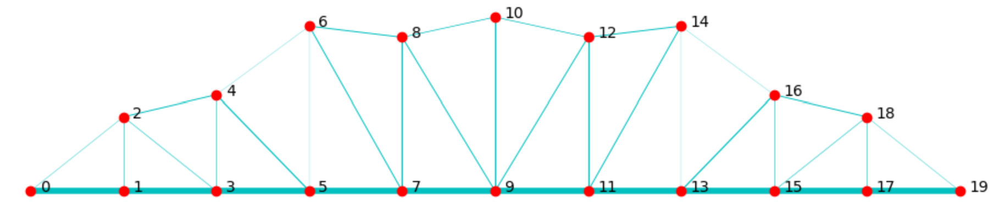
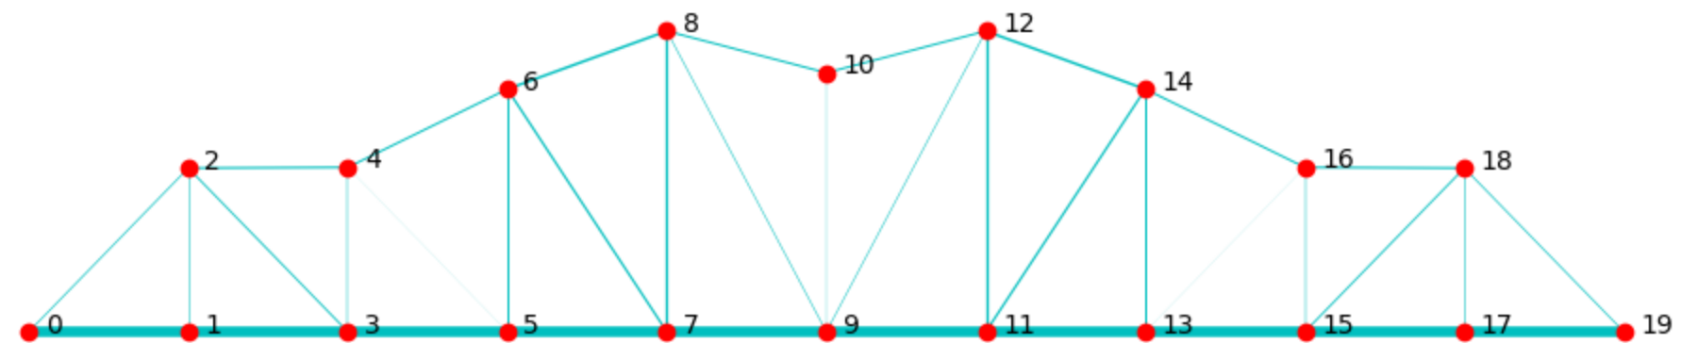
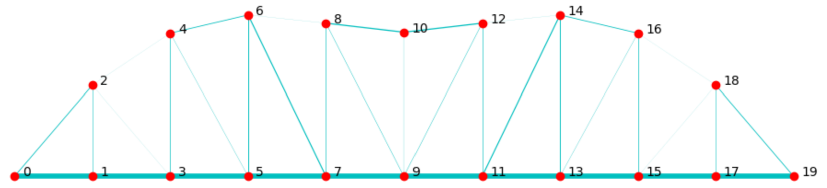
Loss function – Comparison 2
 | Natural frequencies [Hz] | Best score | Total mass [kg] | Computation time [Hr] | Structure visualization for best iteration
Case 5 Same as (3) | 19.40, 52.24, 66.39 | 5884.91 | 449.99 | 3.29
Case 6 | 18.14, 42.19, 63.27 | 43691.6 | 426.26 | 3.06
Case 7 Same as (2) | 18.14, 50.93, 93.04 | 1822.51 | 476.76 | 3.13
Case 8 | 18.27, 44.26, 79.23 | 3663.74 | 473.01 | 3.62
Case 9 Same as (1) | 22.13, 46.83, 61.97 | 4808.60 | 480.86 | 3.40
Case 10 | 15.92, 44.99, 74.57 | 5772.35 | 460.57 | 2.83
Notes:
In case 5 and 6, we optimized for the coefficient of the mass score by improving upong case where all the three modes of frequencies were guided. When optimizing for mass, we saw a great improvement in the toal mass, however, the natural frequncies would also be violated due to their natural physical relationship.
Hence, in the last four cases we seeked a combination of penalties on the mass score and frequency from case 3 where we applied the threshold guidance to only 20 Hz range in which we arrived at case 9 which was a combination of coefficient of 10 and 100 for the mass score and lower bound of frequency respectively. This ended with the same result from case, which was a great improvement in terms of generalization, however, with an associated cost for the computation time.

Slide 16
Constraining area boundaries
The initial interval corresponds approximately to sections between CHS 21.3/2.3 and CHS 114.3/3.2. Smaller and larger intervals are tried to evaluate their influence on results and computation time.
1: [0.00001, 0.001] for all sections
2: [0.00005, 0.0005] for all sections
3: [0.00001, 0.0005] for all sections
4: [0.000005, 0.005] for all sections

Slide 17
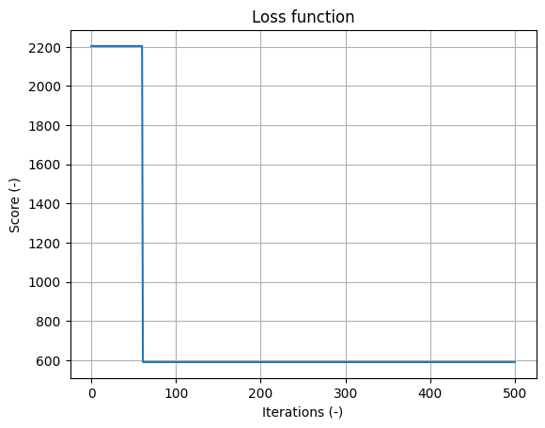
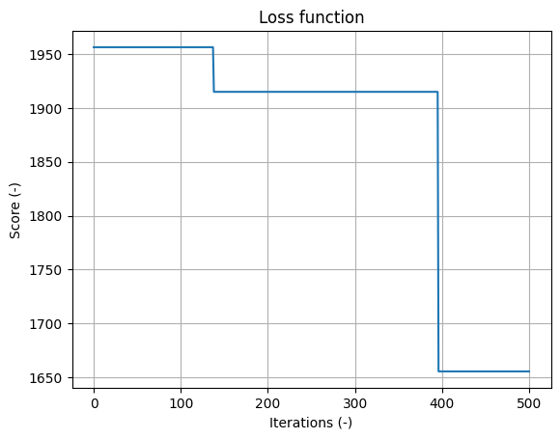
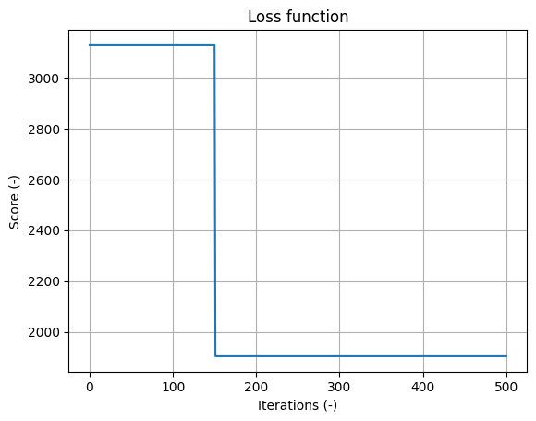
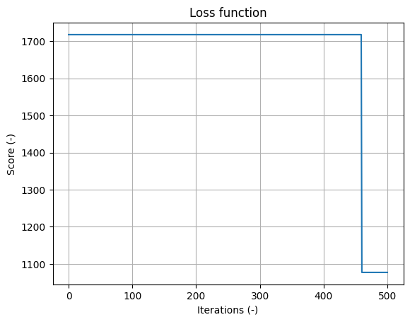
Constraining area boundaries
1.
2.
3.
4.

Slide 18
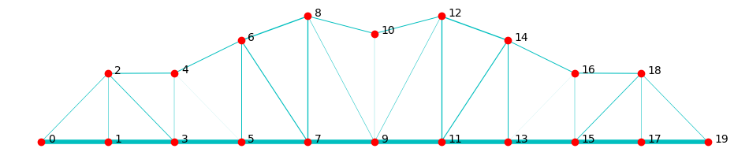
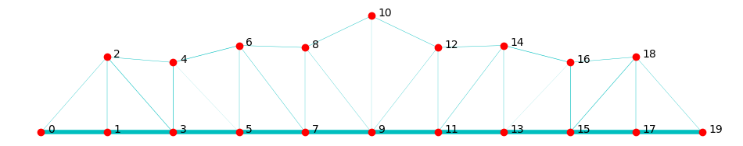
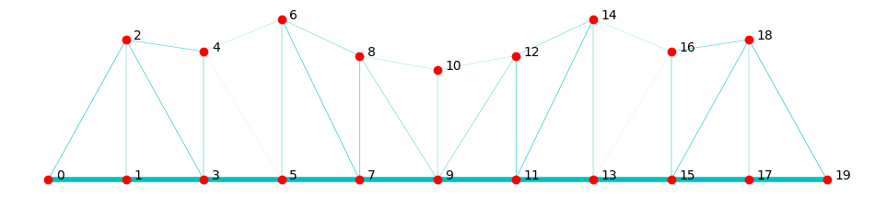
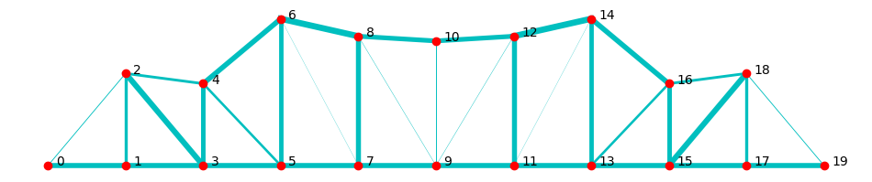
Constraining area boundaries
Area boundaries | Natural Frequencies [Hz] | Total Mass [kg] | Final Score | Computation time [hr] | Structure visualization for best iteration
[0.00001, 0.001] | 22.1, 46.8, 62.0 | 480.9 | 591.09 | 2.6
2. [0.00005, 0.0005] | 15.9, 44.7, 65.2 | 387.2 | 1655.66 | 2.3
3. [0.00001, 0.0005] | 14.6, 49.7, 62.2 | 416.4 | 1904.34 | 3.1
4. [0.000005, 0.005] | 20.7, 42.4, 61.2 | 1061.7 | 1077.20 | 3.4

Slide 19
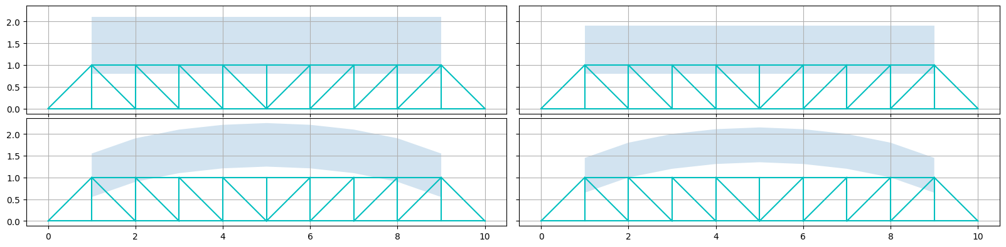
Constraining node boundaries
Standard: Flat boundaries with 1,6 meter band
1: Flat boundaries with 1,3 meter band
2: Flat boundaries with 1,1 meter band
3: Arch shape with 1 meter band
4: Arch shape with 0,8 meter band

Slide 20
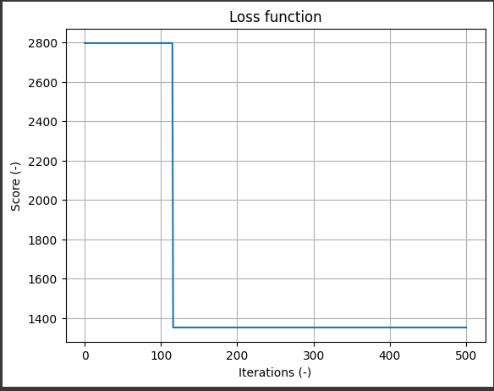
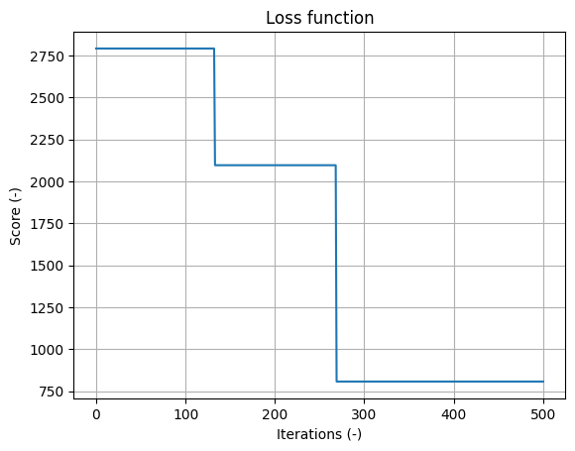
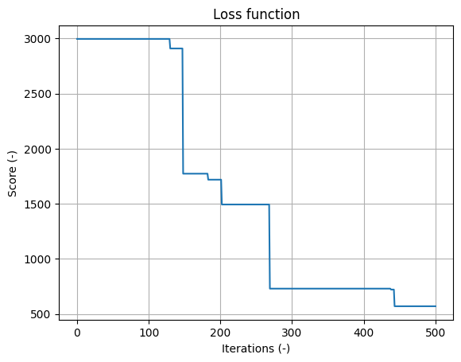
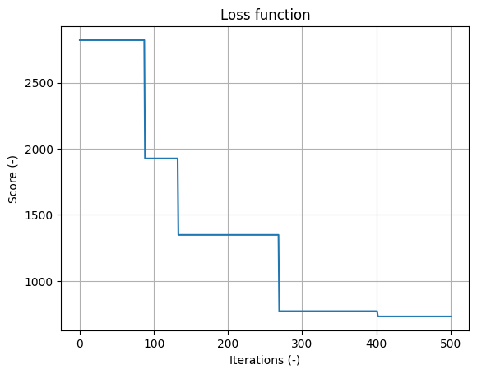
Constraining node boundaries
1.
2.
3.
4.

Slide 21
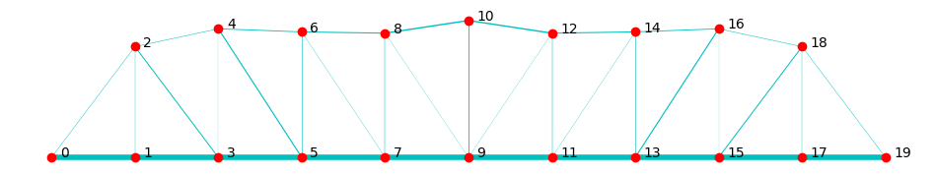
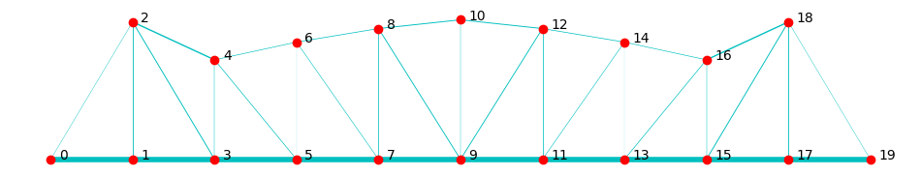
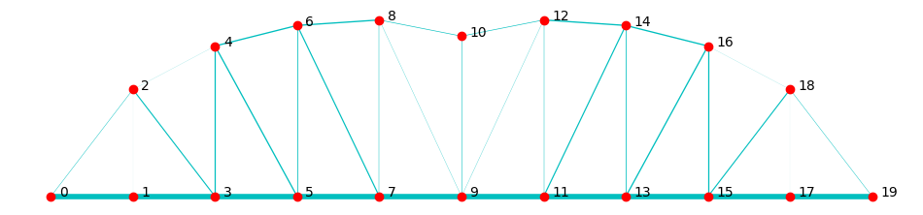
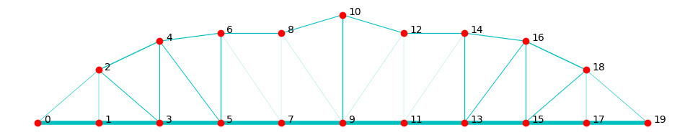
Constraining node boundaries
Boundaries | Natural Frequencies [Hz] | Total Mass [kg] | Final Score | Computation time [hr] | Structure visualisation
1.3 m flat | 23.8, 51.2, 77.6 | 449.5 | 1352.39 | 3.1 - 11%
2. 1.1 m flat | 20.5, 47.1, 70.9 | 468.3 | 806.78 | 2.6 - 26%
3. Arch, 1m | 22.0, 41.8, 64.7 | 510.7 | 569.80 | 1.1 - 69%
4. Arch, 0.8m | 23.4, 43.7, 70.1 | 475.7 | 732.79 | 1.0 - 71%

Slide 22
Kernel optimization
Compare different kernels based on computation time and minimized mass:
Squared Exponential
Matérn
Gamma Exponential
Rational Quadratic

Slide 23
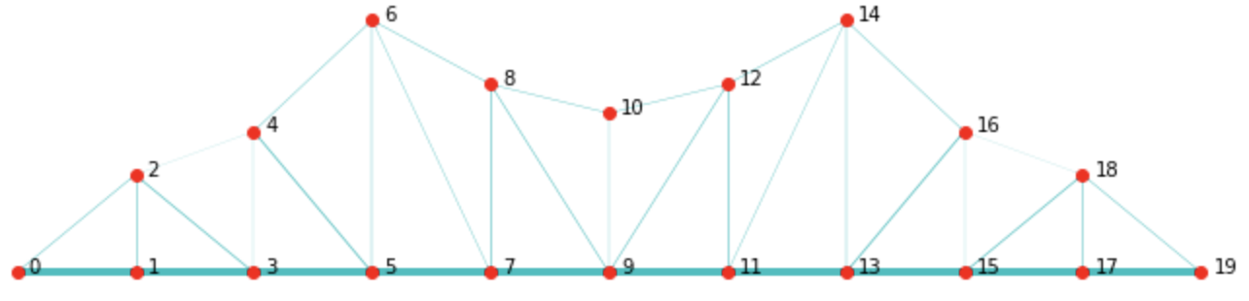
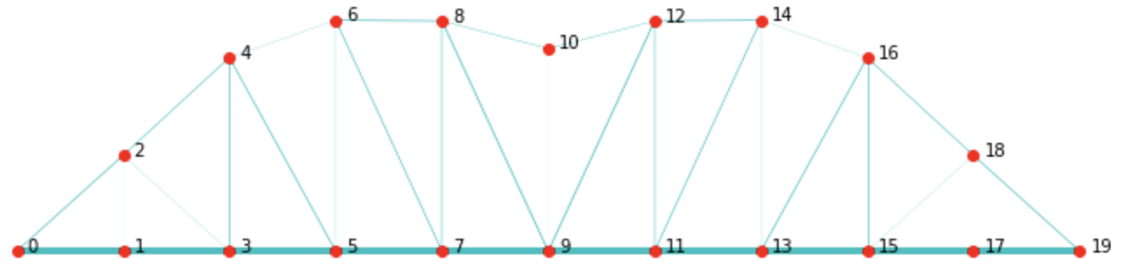
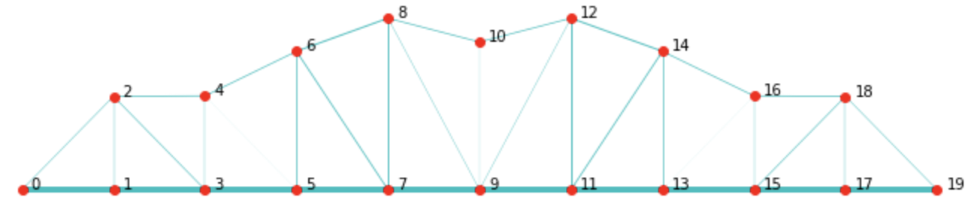
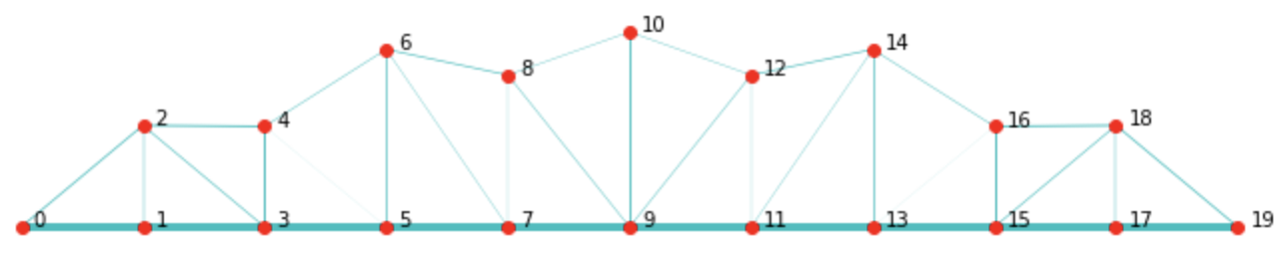
Kernel optimization
Kernels | Natural Frequencies [Hz] | Total Mass [kg] | Final Score | Computation time [hr] | Structure visualisation
Squared Exponential | 14.96,46.39, 68.45 | 446.16 | 1924.96 | 1.83
Matérn | 20.45, 52.50, 64.32 | 476.48 | 826.48 | 1.22
Gamma Exponential | 22.13, 46.83, 61.97 | 480.86 | 591.09 | 1.74
Rational Quadratic | 17.65, 42.93, 62.70 | 450.30 | 1537.44 | 2.55

Slide 24
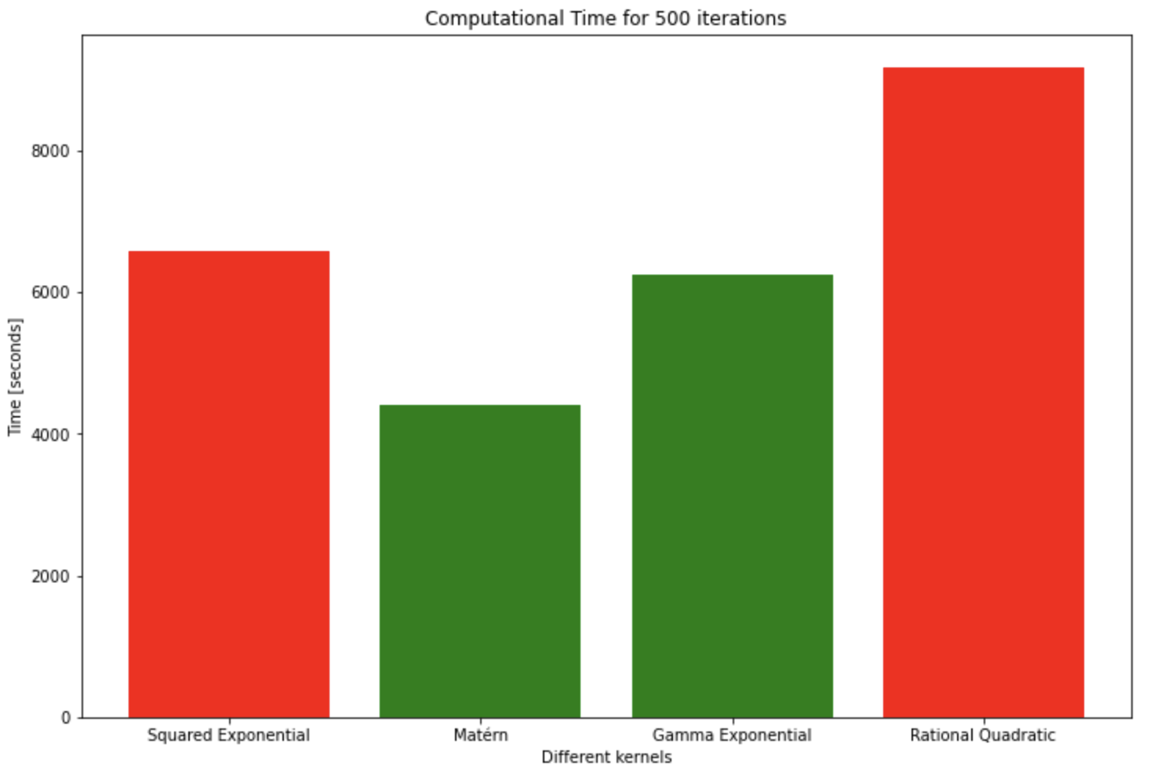
Kernel optimization – Comparison (C.T.)

Slide 25
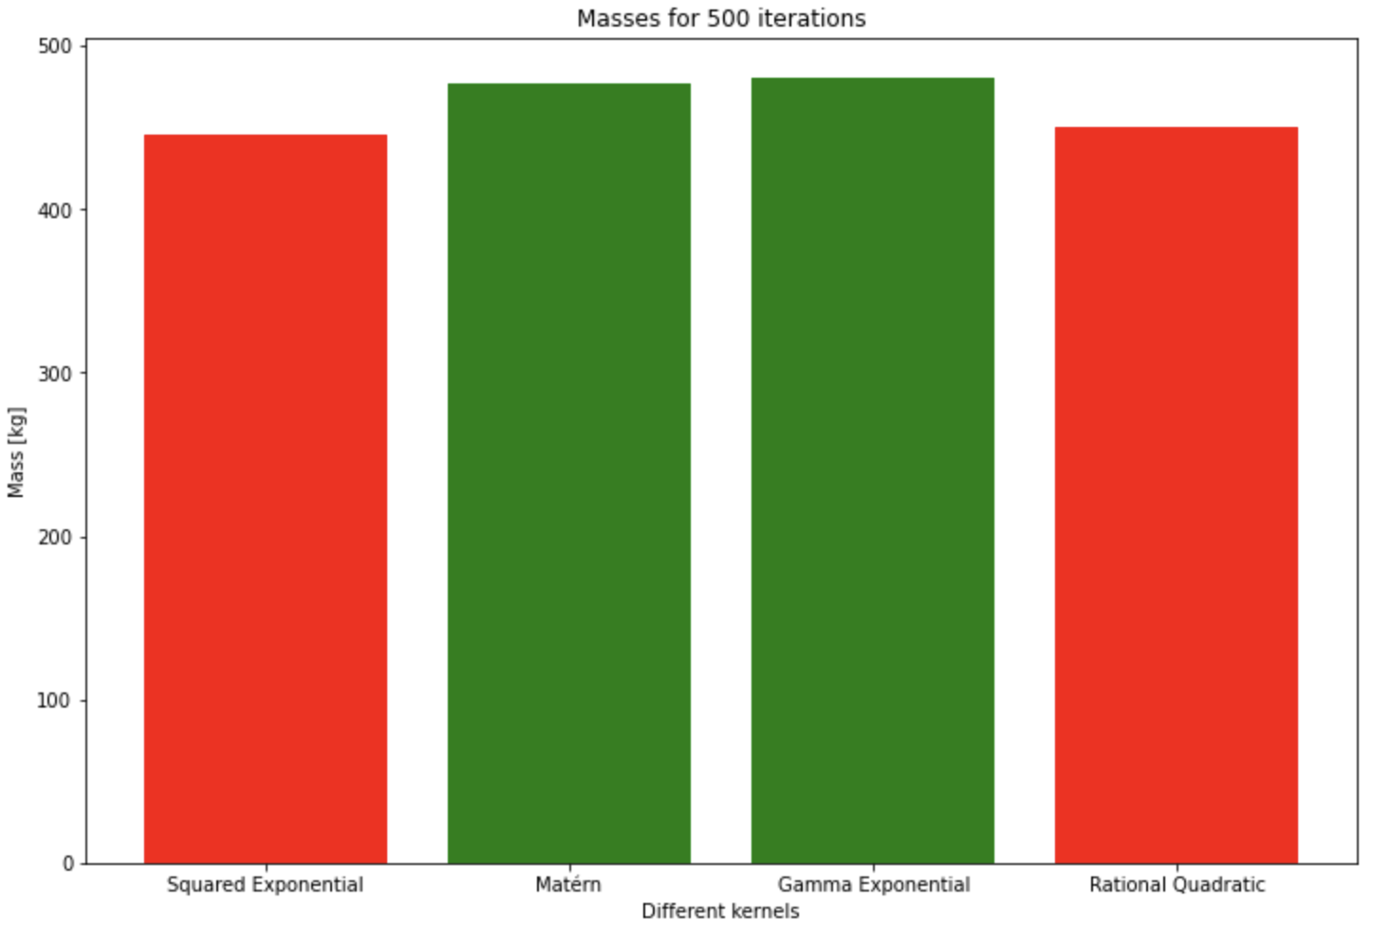
Kernel optimization – Comparison (mass)

Slide 26
Initial evaluation
Checked optimized model with
1, 5, 10, 15, 20 Initial evaluations with FEM to feed Bayesian optimizer
There were no apparent relationship to the total mass or final score with the use of random seed
# of initial evaluations | Natural Frequencies [Hz] | Total Mass [kg] | Final Score
1 | 27.79, 54.76, 75.83 | 480.9 | 1539.03
5 | 23.65, 55.78, 70.85 | 468.9 | 1000.58
10 | 22.13, 46.93, 61.97 | 480.9 | 591.09
15 | 20.43, 51.44, 75.09 | 501.9 | 1219.15
20 | 20.63, 49.84, 68.09 | 479.4 | 804.72

Slide 27
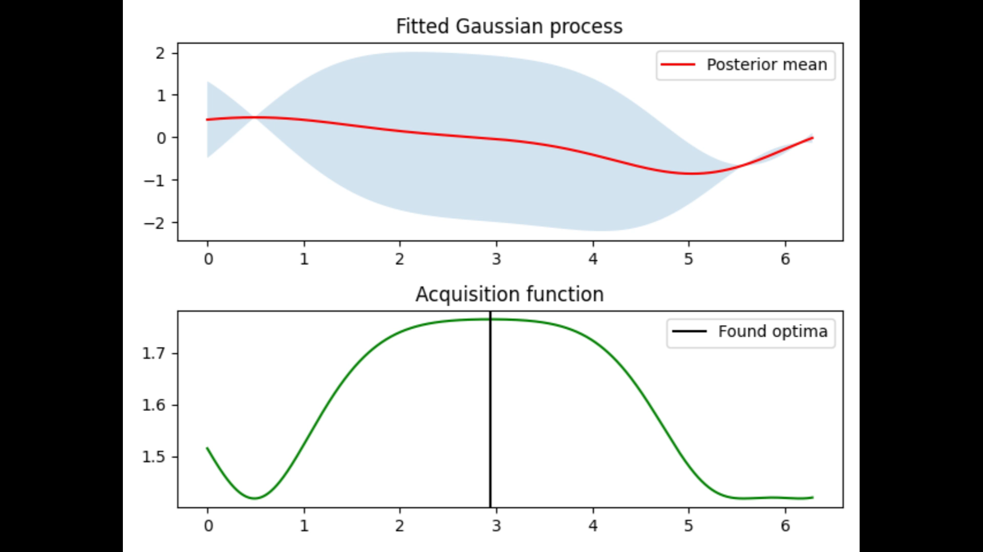
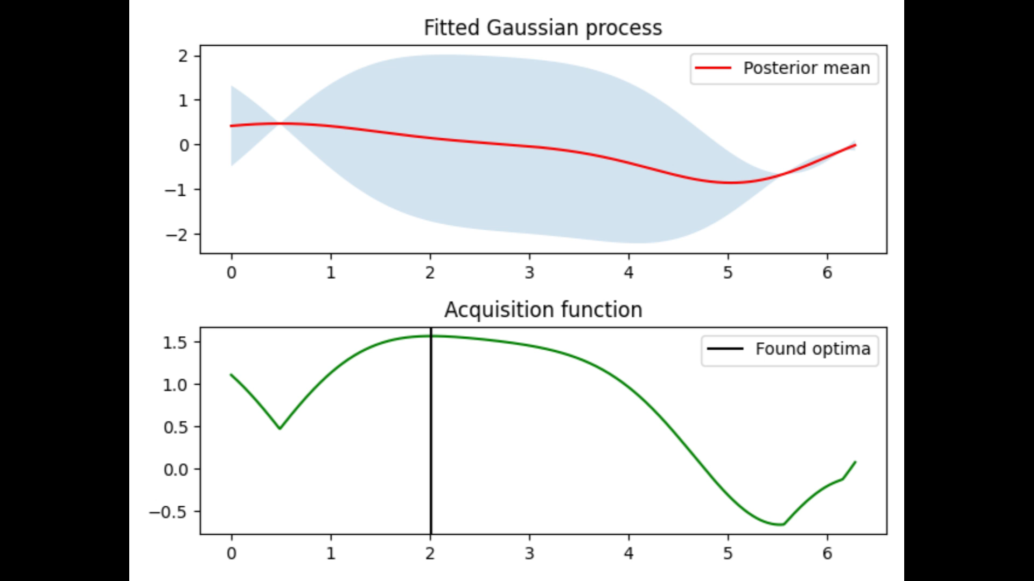
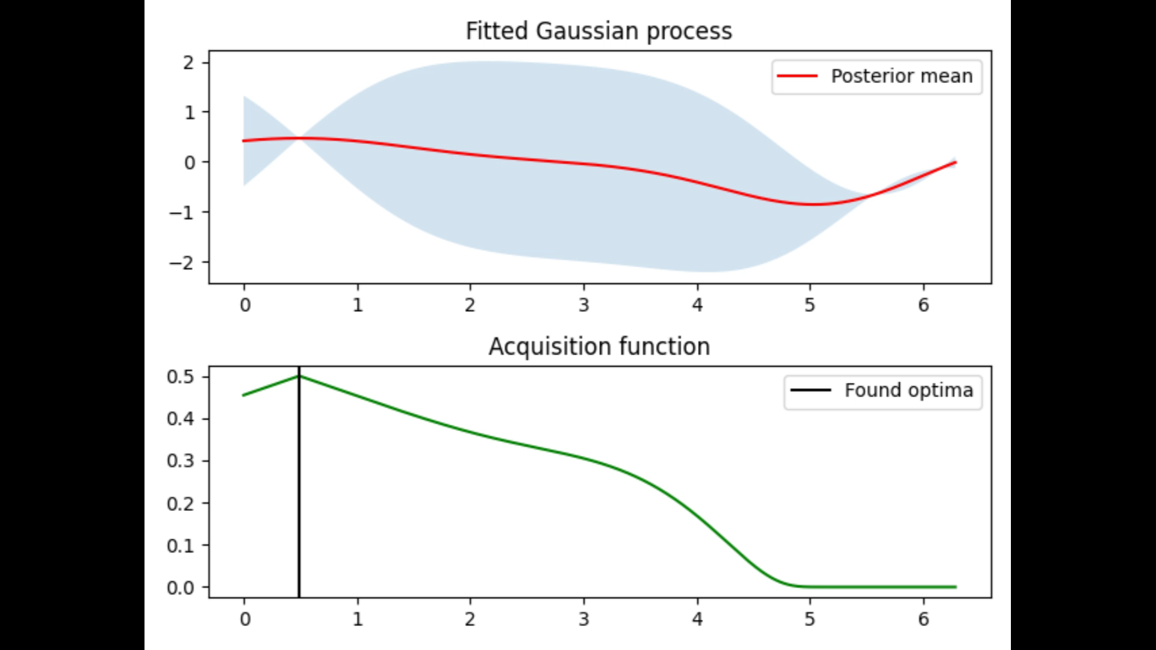
Acquisition functions
Entropy (1D example) UCB (1D example)
Probability of improvement (1D example) Expected improvement (1D example)

Slide 28
Acquisition function: Entropy and UCB
Potential good results
UCB faster convergence compared to Entropy
Both gave errors
500 iterations: 10+ hours
Entropy 1D example UCB 1D example

Slide 29
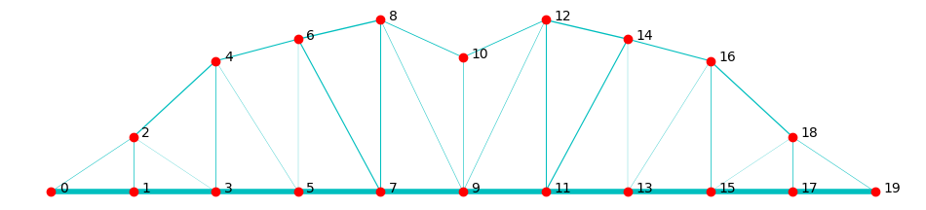
Acquisition function: Probability Improvement
Good loss score
Faster run time
Same reward regardless of the size of the improvement of a new found maximum
Can get stuck on a local optimum
P.o.I. 1D example
Natural frequencies [Hz] | Best score | Total mass [kg] | Computation time [Hr] | Structure visualization for best iteration
20.14, 49.65, 60.99 | 670.69 | 482.320 | 2.33

Slide 30
Acquisition function: Expected Improvement
Comparebale to PoI, but is better at discovering global optimum
Good run time
Good results
Hyperparameter: ξ
Natural frequencies [Hz] | Best score | Total mass [kg] | Computation time [Hr] | Structure visualization for best iteration
20.63, 49.84, 68.09 | 804.72 | 479.43 | 2.57

Slide 31
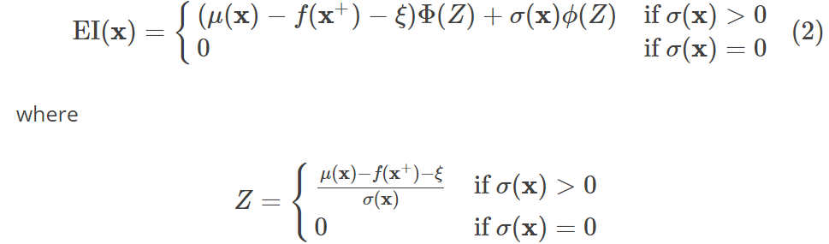
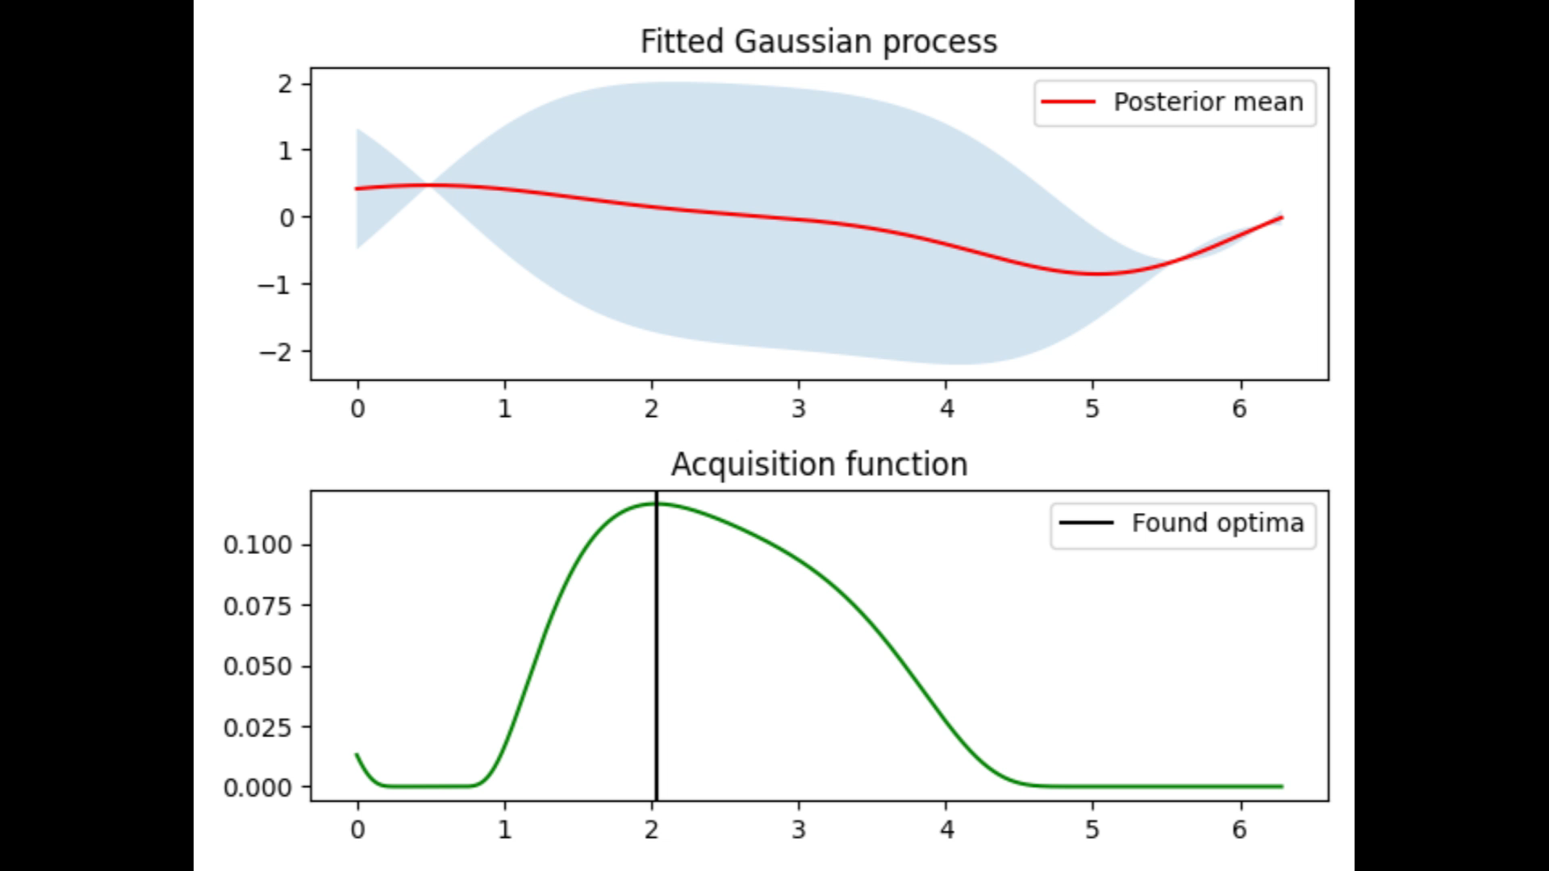
Acquisition function: Trade-off parameter ξ ^{[6]}
Low ξ (1D example) High ξ (1D example)

Slide 32
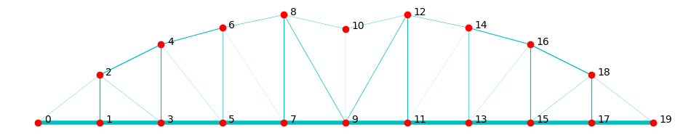
Acquisition function: Expected Improvement
 | Natural frequencies [Hz] | Best score | Total mass [kg] | Computation time [Hr] | Structure visualization for best iteration
High ξ | 19.42, 44.94, 60.23 | 1493.53 | 444.37 | 2.89
Low ξ | 20.14, 49.65, 60.99 | 804.72 | 479.43 | 2.57

Slide 33
Exploitation
of the final model

Slide 34
Final model
Optimized parameters:
Loss-function: Least squares for all frequencies
Acquisition function: Expected Improvement (ξ = 0)
Area bound: [0.00001, 0.001]
Node bound: [0.6, 2.2]
Kernel: Matern
Iterations: Up to 3000

Slide 35
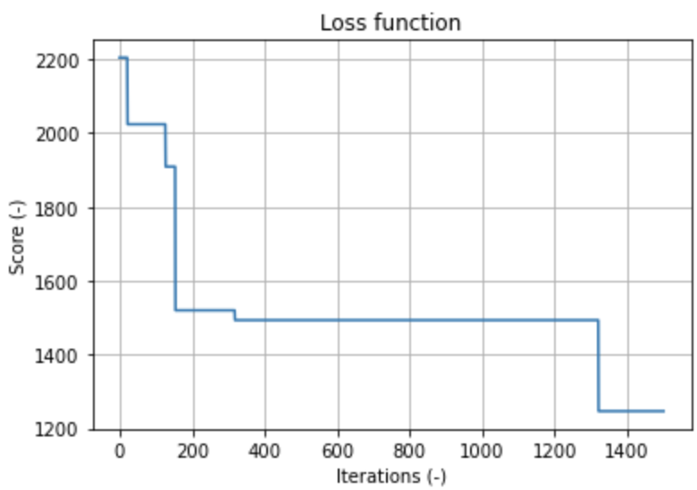
Final model: Issues
Problem: computational time vs. remaining time frame
Also prone to errors: GoogleColab
1500 iterations took more than 18 hours.
3000 estimated to several days

Slide 36
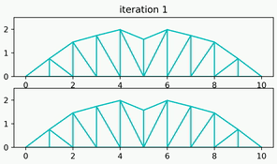
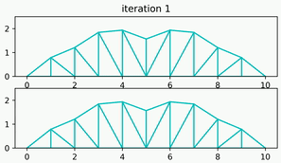



Final model: Optimization
Solution:
Run multiple models of 500 iterations sequentially
Use the results from the first model as boundaries for the second model
Repeat until a satisfying solution has been found

Slide 37







Final model: Results
Run | Natural Frequencies [Hz] | Total Mass [kg] | Final Score | Computation time [hr] | Structure visualisation
1 | 20.62, 49.83, 68.09 | 438.31 | 804.72 | 0.71
2 | 21.23, 42.38, 60.51 | 471.28 | 479.87 | 0.69
3 | 20.44, 40.70, 60.92 | 477.16 | 461.95 | 0.82
4 | 21.30, 40.29, 60.27 | 455.62 | 461.87 | 0.70
5 | 20.17, 40.94, 61.52 | 450.13 | 465.02 | 0.75
6 | 20.41, 42.16, 61.28 | 455.80 | 467.69 | 0.8
7 | 20.33, 40.21, 60.65 | 447.95 | 456.13 | 0.77

Slide 38
Discussion: Final model
Pros:
Decreased computational time
Better solution
Cons:
Losing a lot of information gained by the Bayesian model
Potential of taking a local optimum as boundary for next model

Slide 39
Discussion: Bayesian optimization
Optimal truss design
Kanarachos: ~360 kg
Only eigen frequencies and mass
Too low mass penalty, optimizing towards low frequencies
Suitability of Bayesian optimization
Preliminary screening
Efficient in reaching optimal solution
Recurrent, non-parametric model
Generality versus computation time
The more general the model, the more computation time needed

Slide 40
Sources
Nag, A. (2022, 6 januari). Bayesian Optimization: A Step by step approach - towards data science. Medium. https://towardsdatascience.com/bayesian-optimization-a-step-by-step-approach-a1cb678dd2ec
Opt.Vink, R. (2019, 25 augustus). Algorithm Breakdown: Bayesian Optimization. Ritchievink. https://www.ritchievink.com/blog/2019/08/25/algorithm-breakdown-bayesian-optimization/
Kanarachos, S., Griffin, J., & Fitzpatrick, M. E. (2017). Efficient truss optimization using the contrast-based fruit fly optimization algorithm. Computers & Structures, 182, 137–148. https://doi.org/10.1016/j.compstruc.2016.11.005
Acquisition function animations: https://github.com/josejimenezluna/pyGPGO/blob/master/examples/example1d.py
Shahriari, B., Swersky, K., Wang, Z., Adams, R. P., & De Freitas, N. (2016). Taking the human out of the loop: A review of Bayesian optimization. Proceedings of the IEEE. http://doi.org/10.1109/JPROC.2015.2494218
Bayesian optimization - Martin Krasser’s Blog. (2018, March 21). https://krasserm.github.io/2018/03/21/bayesian-optimization/

